Slide 1
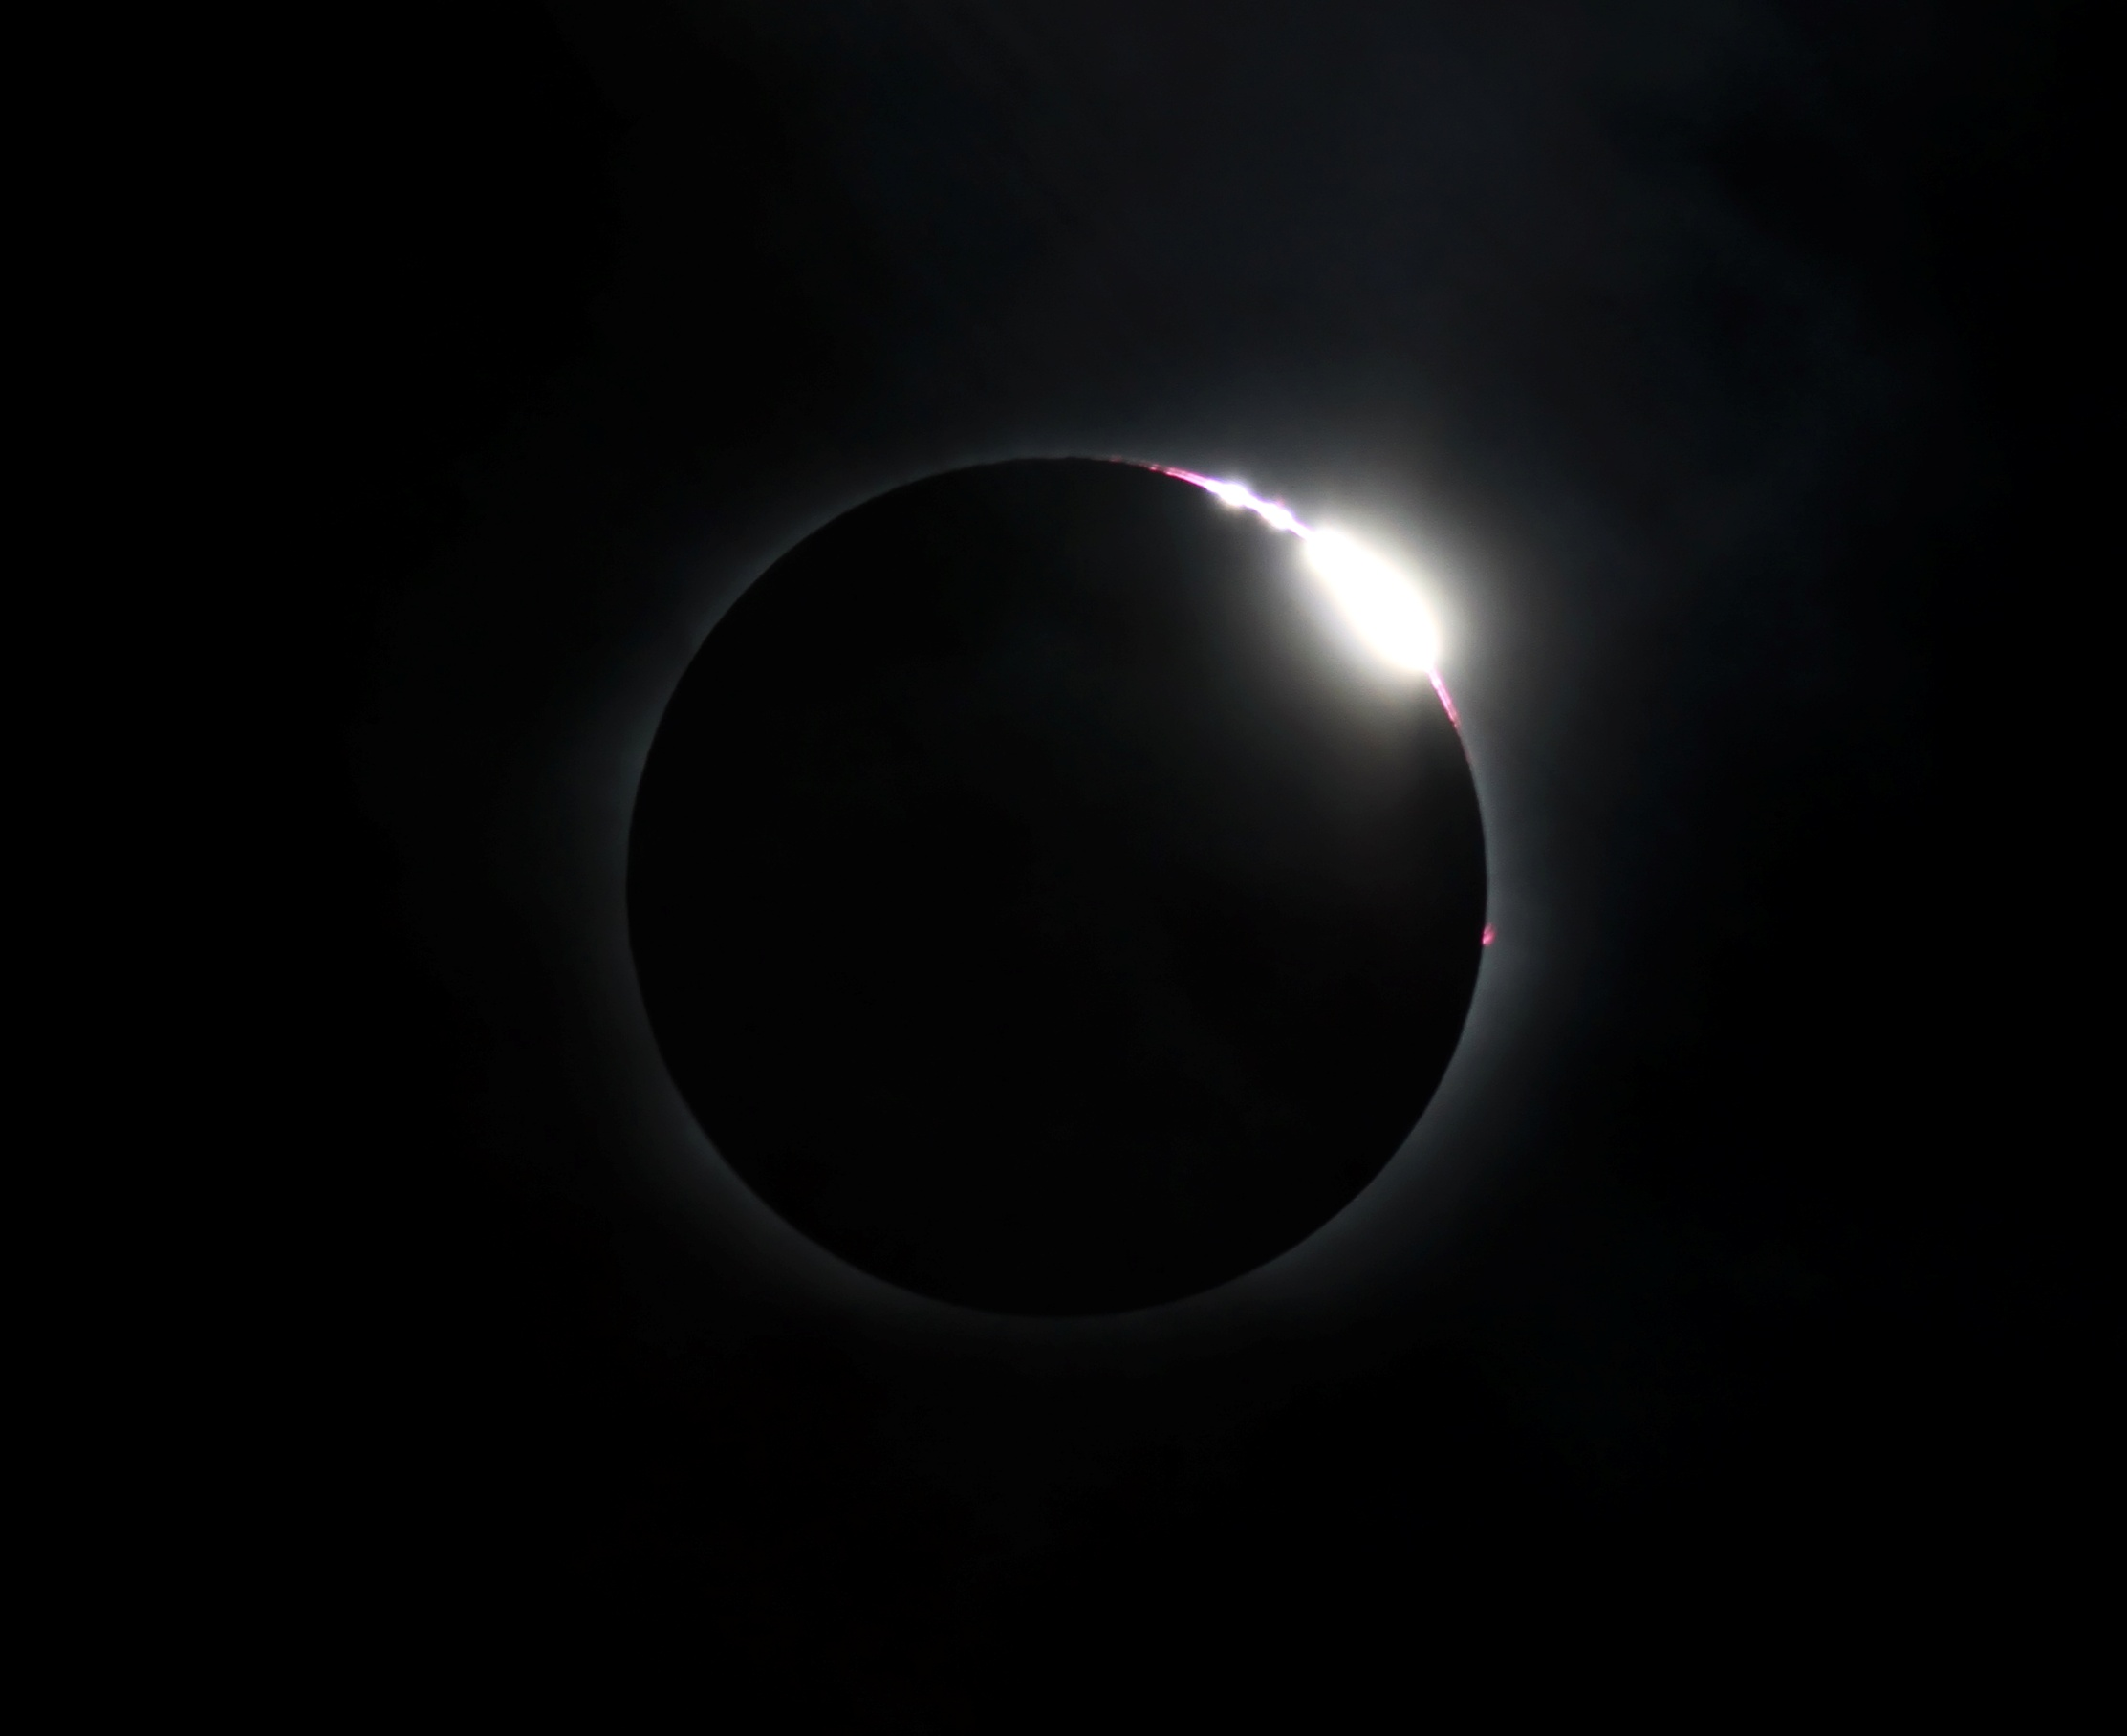
Under The Shadow:
public eclipse education
Melissa Hulbert^{1,2} and Toner Stevenson^{1,3}
Sydney Observatory, Museum Applied Arts and Sciences (MAAS), Sydney, Australia;
Swinburne University, Centre for Astrophysics and Supercomputing, Melbourne, Australia;
Museum Studies, Faculty of Arts, The University of Sydney, Australia
Email: melissah@phm.gov.au
International Solar Eclipse Conference
23-26 October 2014, New Mexico

Slide 2
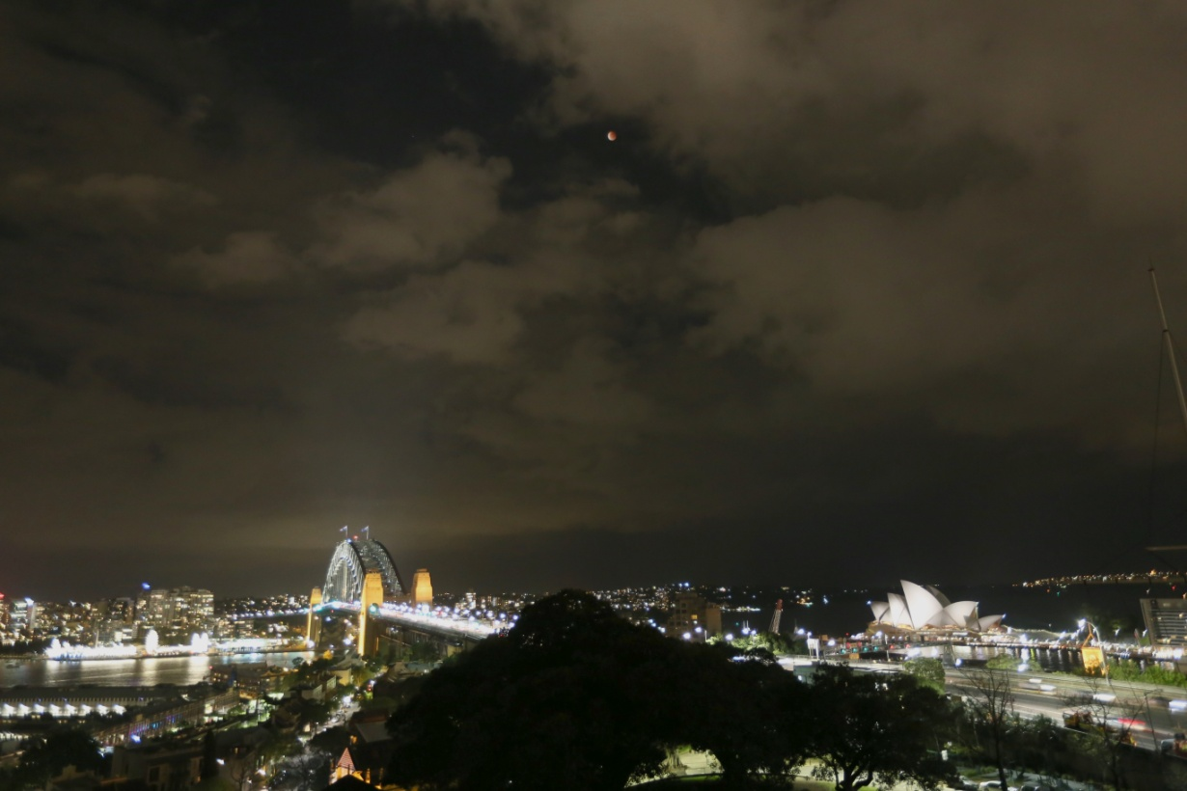
Over 150 years...
Since 1857 Sydney Observatory has been communicating eclipses with the
Australian public through the media, eclipse expeditions and photographic
recounts.
The past 150 years have seen great change in technology which has impacted
on the quality and quantity of information communicated with the public as well
as the audience reach.
The focus of this talk covers how Sydney Observatory has communicated eclipses
to the public from 1857 until the present day.
© Melissa Hulbert, 2014

Slide 3
Communicating in the past
In 1871 Sydney Observatory Director, Henry Chamberlain Russell, joined an
expedition to Cape York, on the northern tip of Australia.
Amongst the astronomers, included members of the public paying their way for a
berth on the steamer at £25 each.
Nature magazine published the 1871 eclipse preparations.
Photographs have recently been found of this expedition, but unfortunately none
were taken of the eclipse as it was cloudy.
It was through illustrated newspaper
accounts of the partial eclipse as seen
in Sydney by John Tebbutt that the
public imagination was captured.
Sydney Observatory: MAAS Collection.

Slide 4
Photographic Era
Preparations were documented and the images circulated.
The aim of eclipse astronomers became to not only observe, time and note the
eclipse phenomena, but to photograph the corona, Baily’s beads and the
diamond ring effect.
Tahiti eclipse in 1908
Bruny Island, Tasmania in 1910
Vavau in the Fiji Islands in 1911
Images provide great social
comments about eclipse
expeditions and evidence that
women participated in eclipses,
as well as the professional
astronomers who were male.
Sydney Observatory astrographic
astronomer, James Short,
photographed all of these
expeditions.
Sydney Observatory: MAAS Collection.

Slide 5
“ A low murmur of almost suppressed excitement escaped from the still increasing throng as someone was heard to say '-First contact.' Hundreds of smoked glasses were lifted to their owners' eyes, and the curved edge of the moon could just be seen on the sun's edge.” (Cooke, W.E., 1922)
The Einstein Eclipse 1922
Photography was the main purpose of the 1922 expedition to Goondiwindi,
Queensland, Australia.
Newspaper articles, a book and photographs of preparations, the equipment
and the results were made widely available and public excitement, as shown in
the above quote, was at a high level.
Sydney Observatory Director, W.E. Cooke found the throngs of public who
came to view the eclipse a nuisance.

Slide 6
Lick Observatory expedition at
Wollal in Western Australia
managed to prove Einstein’s
General Theory of Relativity
through comparisons made using
their photographs of the stars
taken during totality.
It was not only the astronomical
images which have left a legacy,
the photographs of people and
equipment now hold social
significance in Museum collections.
Sydney Observatory: MAAS Collection.

Slide 7
Sydney Observatory: MAAS Collection.

Slide 8
Sydney Observatory: MAAS Collection.

Slide 9
Sydney Observatory: MAAS Collection.

Slide 10
Public Eclipse Tours
  Sydney Observatory is now a public observatory, astronomy education centre
  and part of the Museum of Applied Arts and Sciences (MAAS).
Woomera, South Australia 2002
Novosibirsk, Russia 2008
Easter Island, Chile 2010
Port Douglas, Australia 2012
Blogs on Sydney Observatory’s website are an important way to communicate
the eclipse tours and eclipse day with several blogs and images posted before,
during and after the tour.
Subsequent articles in magazines by both staff and participants.
Provided a way to communicate the excitement and observations during
the eclipse, thus reaching a broad audience.

Slide 11
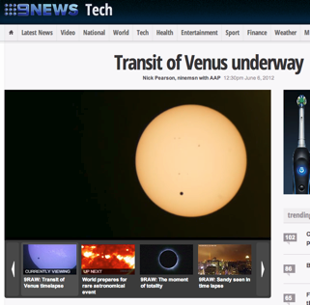
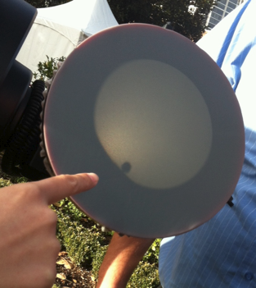
Port Douglas 2012: Live streaming and social media
Technology in the past few years has changed dramatically.
Instant “real time” imaging was the key to broadening access to a wider audience.
Ninemsn, 2012
The VuVu Venus, © Toner Stevenson, 2012

Slide 12
Port Douglas: 14 November, 2012
A live video stream for the solar eclipse via the Sydney Observatory website
provided unique challenges.
The feed was sent to the laptop and then via
the 3G network to Sydney Observatory’s
website and YouTube.
Hundreds of thousands of people viewed the
eclipse via the live stream, regularly crashing
the Museum’s website.
The live feed was also picked up onsite at
Sydney Observatory where 200 early morning
visitors were eagerly watching the eclipse as
rain obscured views of the partial eclipse.
© Toner Stevenson, 2012

Slide 13
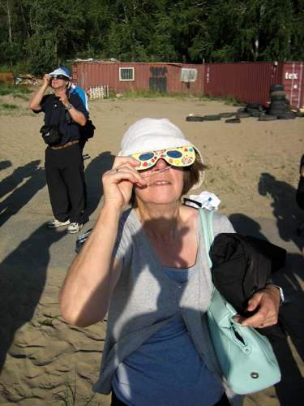
In the vicinity of 40,000 ‘likes’ were received on Sydney Observatory’s
Facebook page and 25,000 @sydneyobs Twitter views.
Still images have proven vital, not only of the eclipse but also as social and
cultural records including observers.
© Andrew Jacob, 2008
© Margaret Davis, 2008
© Melissa Hulbert, 2010

Slide 14
Conclusions
Eclipses have, and continue to draw great interest and curiosity from the public.
Articles in magazines now replace scientific papers as Sydney Observatory is a
public education museum rather than a scientific place of research.
Images rarely appeared in early publications, instead there were verbal accounts
of what was witnessed. Now a ‘picture is worth a thousand words’ and even more
so if in ‘real time’.
Social media such as Blogs, Facebook and Twitter play a big part in communicating
science to a predominantly non-science audience around the globe.
Live-streaming is an effective connection between scientists, educators and
photography enthusiasts with the public through virtual observation.

